Slide 1
Analysing International Debt Statistics
Wireframe Documentation
By
Harsh Sharma

Slide 2
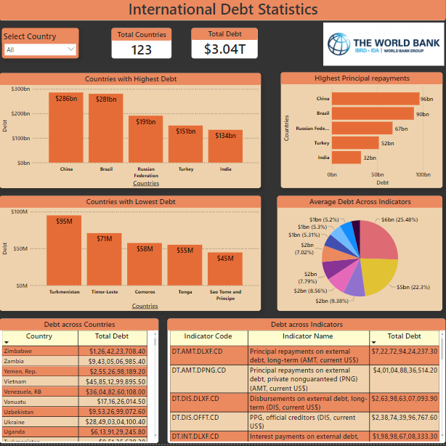

Slide 3
Key Insights From the Project
The world bank is owed over USD $3 trillions.
China leads the Table with a massive debt of USD $ 285Bn across all debt indicators , followed by brazil with a debt of USD $281bn across all debt indicators.
China also leads the table with highest amount of Principal payments amounting to USD $96 bn.
4. Indicator Code DT.AMT.DLXF.CD and DT.AMT.DPNG.CD are the highest amount of
average debt indicator counting to 203 times.

